Slide 1
EMTH403
Mathematical Foundation for Computer Science

Slide 2
Lecture Outcomes
understand what are path, cycles and connectivity in a graph.
understand how to discard an isomorphism with the help of cycles.

Slide 3
Connectivity - Path
Many problems can be modeled with paths formed by traveling along the edges of graphs.
For instance, the problem of determining whether a message can be sent between two computers using intermediate links can be studied with a graph model.
Problems of efficiently planning routes for mail delivery, garbage pickup, diagnostics in computer networks, and so on can be solved using models that involve paths in graphs.

Slide 4
Connectivity - Path
Informally, a path is a sequence of edges that begins at a vertex of a graph and travels from vertex to vertex along edges of the graph.
As the path travels along its edges, it visits the vertices along this path, that is, the endpoints of these edges.

Slide 5
Connectivity - Path
A formal definition of paths and related terminology is given below.

Slide 6
Connectivity - Path
Let n be a nonnegative integer and G an undirected graph.
A path of length n from u to v in G is a sequence of n edges e₁, . . . , e_{n} of G for which there exists a sequence x₀ = u, x₁, . . . , x_{n−1}, x_{n} = v of vertices such that e_{i} has, for i = 1, . . . , n, the endpoints x_{i−1} and x_{i} .

Slide 7
Connectivity - Path
The path is a circuit if it begins and ends at the same vertex, that is, if u = v, and has length greater than zero.
The path or circuit is said to pass through the vertices x₁, x₂, . . . , x_{n−1} or traverse the edges e₁, e₂, . . . , e_{n}.
A path or circuit is simple if it does not contain the same edge more than once.

Slide 8

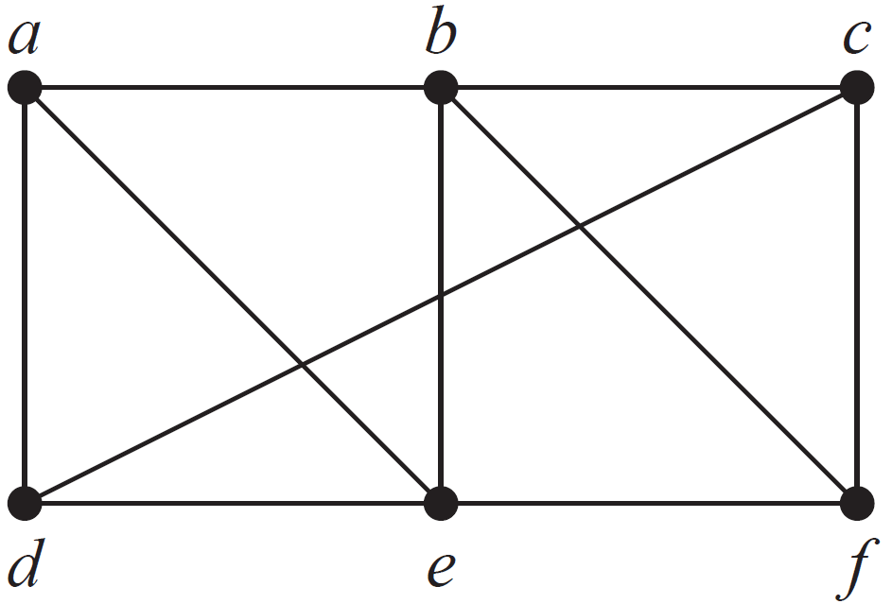
Connectivity - Path
In the simple graph shown in above, a, d, c, f , e is a simple path of length 4, because {a, d}, {d, c}, {c, f }, and {f, e} are all edges.

Slide 9
Connectivity - Path
However, d, e, c, a is not a path, because {e, c} is not an edge.
Note that b, c, f , e, b is a circuit of length 4 because {b, c}, {c, f }, {f, e}, and {e, b} are edges, and this path begins and ends at b.

Slide 10
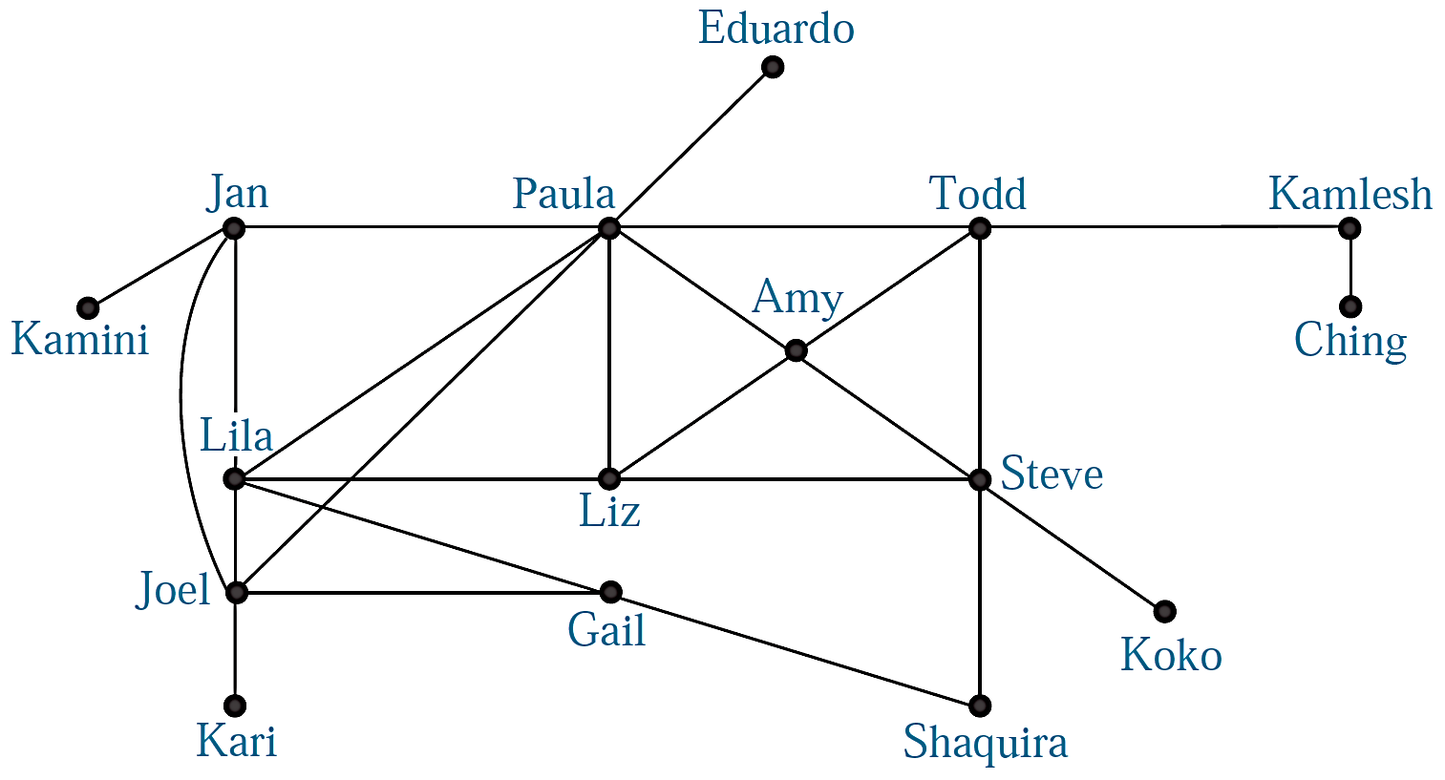
Connectivity – Path - Example
In an acquaintanceship graph there is a path between two people if there is a chain of people linking these people, where two people adjacent in the chain knows one another. For example, there is a chain of six people linking Kamini and Ching

Slide 11
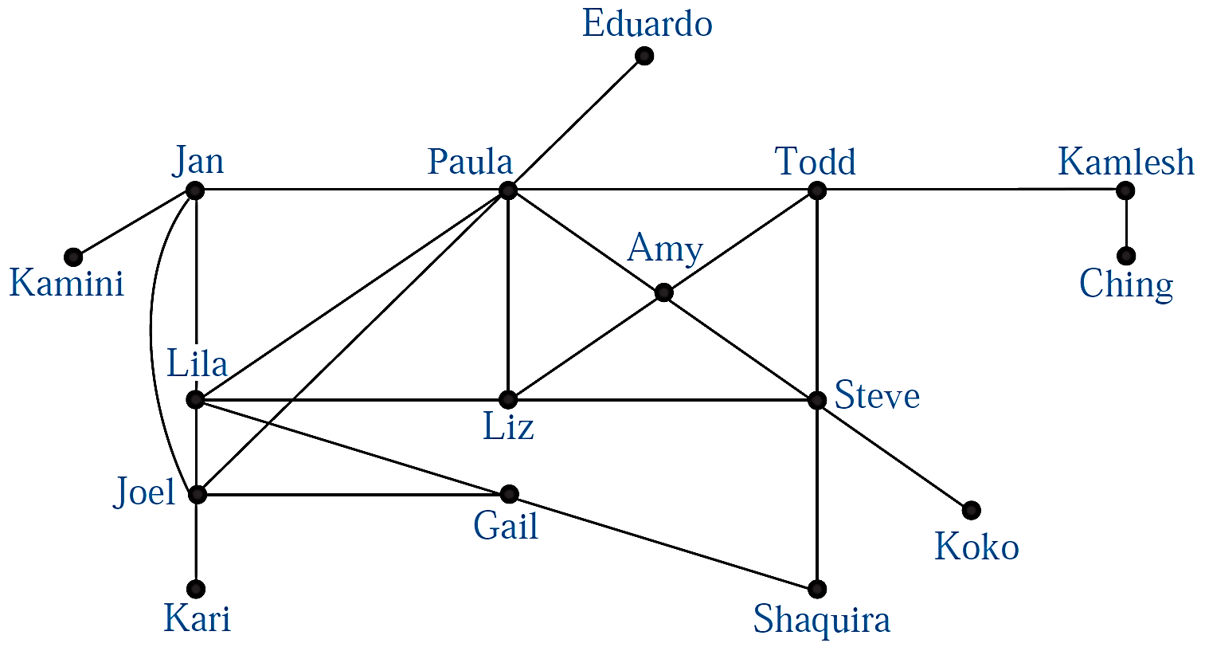
Connectivity – Path - Example
Many social scientists have conjectured that almost every pair of people in the world are linked by a small chain of people, perhaps containing just five or fewer people.

Slide 12
Connectivity – Path
c
f
b
d
a
e
e
W₅
This path passes through vertices f and d in that order.

Slide 13
Connectivity – Path
A path of length n from u to v in an undirected graph is a sequence of edges e₁, e₂, . . ., e_{n} of the graph such that edge e₁ has endpoints x_{o} and x₁ ,
edge e₂ has endpoints x₁ and x₂ ,. . . and edge e_{n} has endpoints x_{n-1} and x_{n} ,
where x₀ = u and x_{n} = v.

Slide 14
Connectivity – Path
This path passes through vertices f, d, e, in that order. It has length 4.
It is a circuit because it begins and ends at the same vertex.
It is called simple because it does not contain the same edge more than once.
c
b
d
f
a
a
e
e
W₅

Slide 15
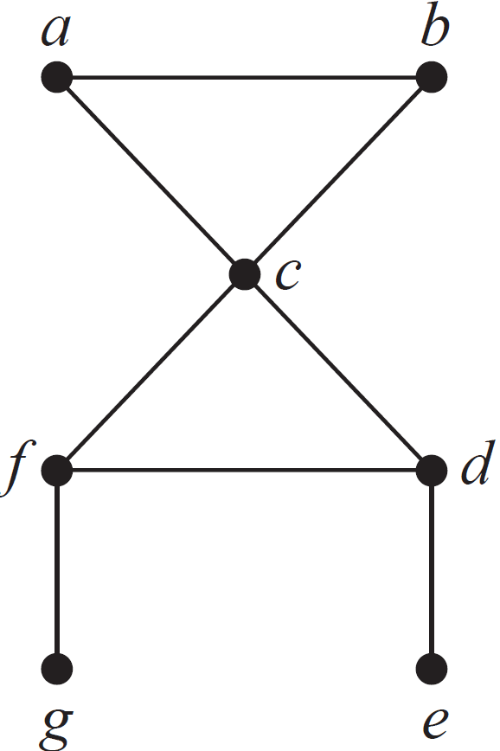
Connectivity – Path
An undirected graph is called connected if there is a path between every pair of distinct vertices of the graph.

Slide 16
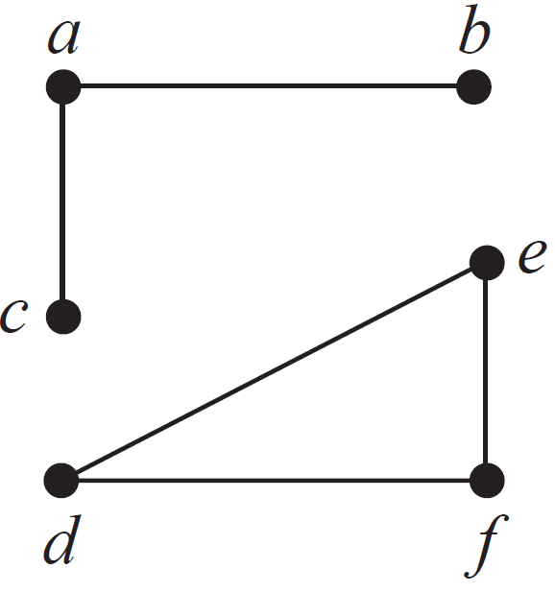
Connectivity – Path
An undirected graph that is not connected is called disconnected.

Slide 17
Connectivity – Path
We say that we disconnect a graph when we remove vertices or edges, or both, to produce a disconnected subgraph.

Slide 18
Connectedness in Undirected Graphs
Definition:- An undirected graph is called connected if there is a path between every pair of distinct vertices of the graph.
IS THIS GRAPH CONNECTED?
c
c
b
f
a
a
e
e
W₅

Slide 19
Connectedness in Undirected Graphs
Theorem:- There is a simple path between every pair of distinct vertices of a connected undirected graph.
c
c
b
f
a
a
e
e
W₅

Slide 20
Graph Isomorphism - Definition
The simple graphs G₁ = (V₁,E₁) and G₂ = (V₂,E₂) are isomorphic if there exists a one to-one and onto function f from V₁ to V₂ with the property that a and b are adjacent in G1 if and only if f (a) and f (b) are adjacent inG₂, for all a and b in V₁.
Such a function f is called an isomorphism.∗ Two simple graphs that are not isomorphic are called non-isomorphic.

Slide 21
Graph Isomorphism
Ques:- Are the pairs of graphs are isomorphic?
Ans:- Hint: Check Cycles
Not isomorphic, the right-hand side graph contains a triangle, but the left-hand side graph does not.

Slide 22
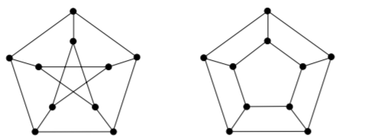
Graph Isomorphism
Ques:- Are the pairs of graphs are isomorphic?
Ans:- Hint: Check Cycles
Not isomorphic.
First does not contain a cycle of length 4, while the
right graph contains a cycle of length 4.

Slide 23
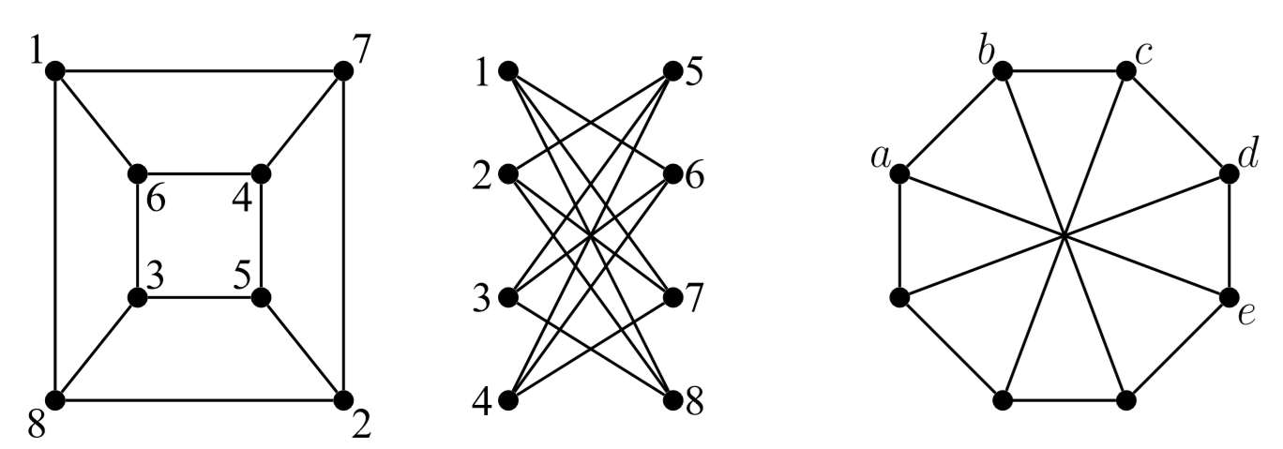
Graph Isomorphism
Ques:- Determine which pairs of graphs below are isomorphic. Justify your answer!
Ans:- The ﬁrst two graphs are isomorphic.
On the other hand, the third graph contains an odd cycle on 5 vertices a,b,c,d,e, thus, this graph is not isomorphic to the ﬁrst two.

Slide 24
Graph Isomorphism
Ques:- Are the following two graphs isomorphic?
a
a
e
b
e
b
c
d
c
d
Sol:- Yes, they are isomorphic, because they can be arranged to look identical. You can see this if in the right graph you move vertex b to the left of the edge {a, c}. Then the isomorphism f from the left to the right graph is: f(a) = e, f(b) = a, f(c) = b, f(d) = c, f(e) = d.

